Slide 1


Analysis of Social Buzz’s Data

Slide 2


Today's agenda
Project recap
Problem
The Analytics team
Process
Insights
Summary

Slide 3

Social Buzz is a technological unicorn that needs to quickly adapts to it’s global scale. . Social Buzz emphasizes content by keeping all users anonymous, only tracking user reactions on every piece of content.
Accenture has begun a POC focusing on these points:
An audit of their big data practice
Recommendations for successful IPO
Analysis of Social Buzz’s current top 5 popular categories
Project Recap

Slide 4

Problem
Due to their rapid growth and digital nature of their core product, the amount of data that they create, collect and must analyze is huge. Every day over 100,000 pieces of content, ranging from text, images, videos and GIFs are posted. All of this data is highly unstructured and requires extremely sophisticated and expensive technology to manage and maintain. They are still a small company and do not have the resources to manage the scale that they are currently at.

Slide 5




Me
Data Analyst
The Analytics team
Marcus Rompton
Senior Principle
Andrew Flemming
Chief Technical Architect

Slide 6
Data Understanding
Process
1
Data Cleaning
2
Data Modelling
3
Data Analysis
4
Uncover Insights
5

Slide 7

Insights
16
Unique
Categories
1897
Reactions to “Animal”
Post
May
Month with
Most Posts

Slide 8
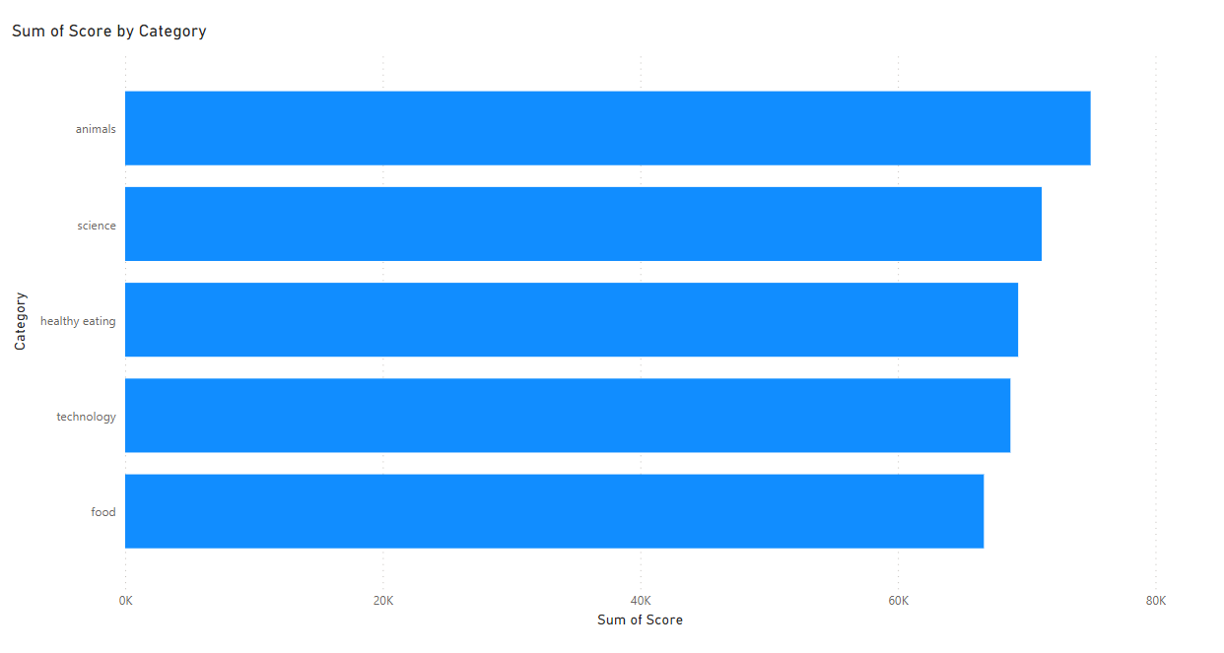

Slide 9
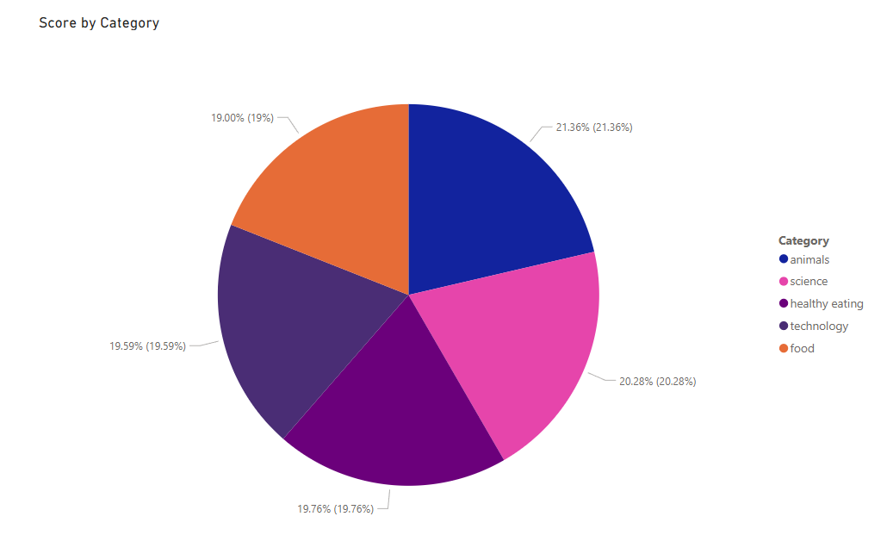

Slide 10
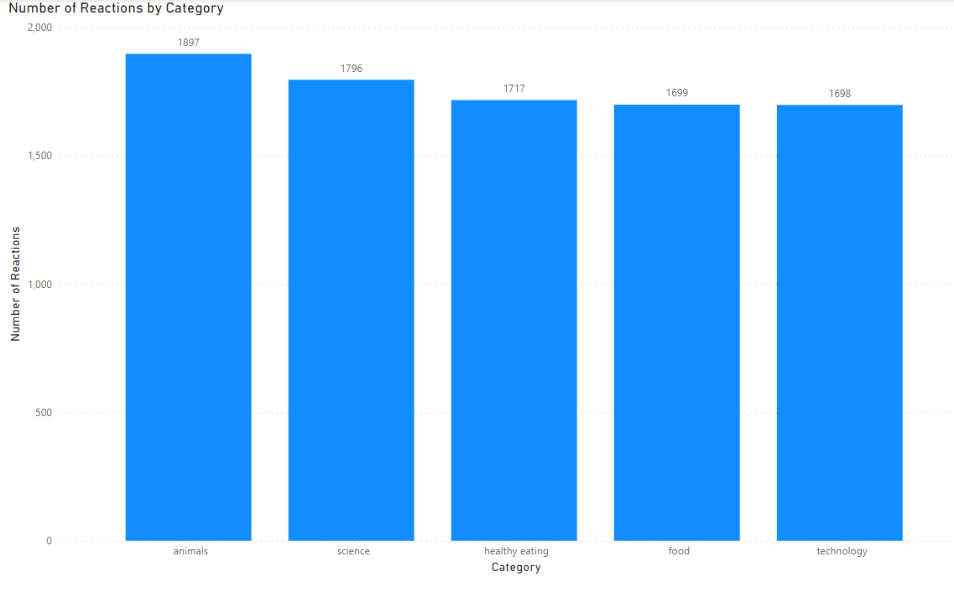

Slide 11
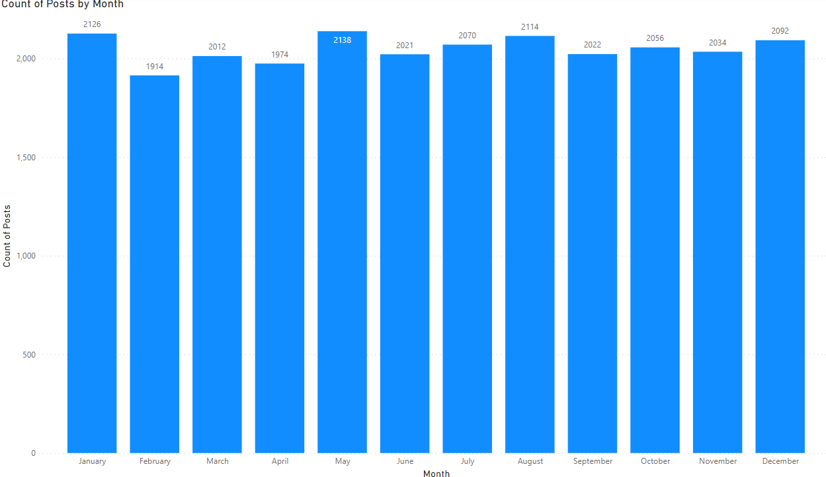

Slide 12

Analysis:
Animal and Science are the two most popular content which shows that the people are most interested in real life things and facts which is a good thing.
Insights:
During the analysis we have found that “Food” is the common theme in top 5 categories with “Healthy eating” at top. You can use this data to promote healthy foods and the brands who are health conscious. This will increase your user interaction.
Summary

Slide 13
Thank you!
ANY QUESTIONS?

